Slide 1
COVID-19 GUIDELINES FOR THE DEPARTMENT OF PSYCHOLOGY AND NEUROSCIENCE
HS RESEARCH
UPDATED.07.17.2020

Slide 2
OVERVIEW
OVCR and the College have placed responsibility for the review and re-opening of labs on the Departments.
Accordingly, this training aims to interpret & distill material from OVCR, OHRE, & SOM in order centralize the Department’s Human Subjects (HS) research policies and procedures.
The timing of this presentation also creates an opportunity to convey this information within the broader context of the Department- and Program-Level reopening plans, which are in progress and we will communicate updates when relevant in this training.
We focus on research in Davie and Howell Howell Halls, as well as PIs, staff, and students, with offices and/or research space(s) in those buildings.
PIs should be aware of & adhere to relevant guidelines at any other research sites, including our Community Clinics which is being coordinated by Dr. Jennifer Youngstrom, Co-Director.

Slide 3
DEPARTMENT PROCESS FOR RESUMPTION OF HS RESEARCH
Part I:
All lab members complete EHS “Protecting the Carolina Community Training”
Part II:
PI submits “Group Resumption of Lab Operations” to the Department
Part III:
PI submits new/modified study protocols to IRB for review/approval
Part IV:
PIs submits IRB approved studies for Department review and approval

Slide 4
PART I: REQUIRED EHS TRAINING

Slide 5

PART I: REQUIRED EHS TRAINING
PIs, staff & all students/other trainees must complete.
Signatures on “Group Resumption of Lab Operations” confirm completion of both EHS & Department Trainings.
https://apps.fo.unc.edu/ehs/training/protecting-the-carolina-community-from-covid-19/

Slide 6
PART II: GROUP RESUMPTION OF LAB OPERATIONS IN DAVIE AND/OR HOWELL HALL

Slide 7
PART II: OVERVIEW
The Department is following OVCR’s directive to use the “Group Resumption of Lab Operations” template (copy at https://psychology.unc.edu/covid/) to inform & guide re-opening.
Resumption of “lab operations” will look different across labs and over time. At least initially, labs may operate entirely remotely. Some may enter buildings in some limited way for specific activities or to pick-up/drop-off materials. Others may be doing in-person human subjects research.
In order to best coordinate activities both within and across labs, we are requiring that all PIs submit an initial resumption plan, which can be modified if/when needed.
Plans will be submitted to reopeningplanspn@gmail.com for review & approval.

Slide 8
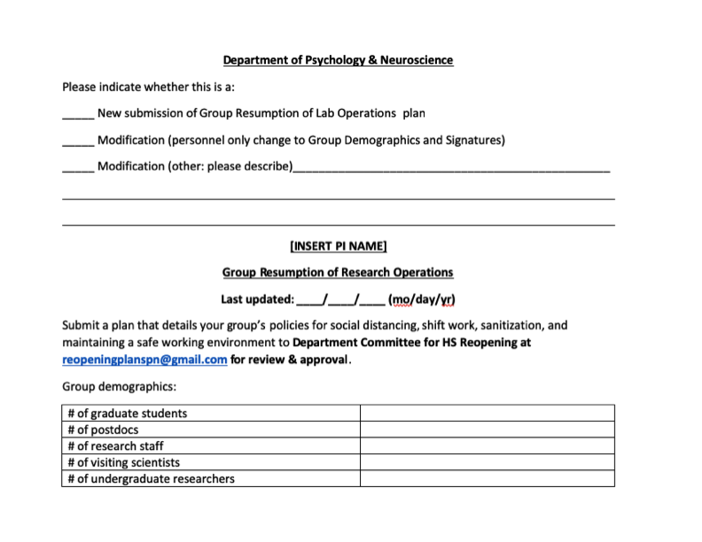
PART II: Overview & General Guidance for CAS Template

Slide 9
Part II: CAS Template (Examples will be provided)
What is your policy for wearing masks?
Include a plan and schedule for sanitization practices in your lab:
How often will surfaces be sanitized?
What is your protocol for sanitizing equipment?
When will personnel wash and sanitize their hands while in the lab?
Detail your plans to maintain social distancing (SD):
How will you stagger work schedules maintain <50% capacity? Log worker attendance? Stagger arrival/departure?
How will you protect lab personnel in areas where SD can’t be met (e.g., between instruments)?
Indicate max occupancy for each room associated with your research program.
Attach a floorplan with demarcated areas (200 sq ft) for guiding SD.

Slide 10
Part II: CAS Template (Examples will be provided)
What is your policy for wearing masks?
Include a plan and schedule for sanitization practices in your lab:
How often will surfaces be sanitized?
What is your protocol for sanitizing equipment?
When will personnel wash and sanitize their hands while in the lab?
Social Distancing:
Work remotely if/when possible;
No visitors;
Stagger schedules (< 50% occupancy) (e.g., Google Calendar, Shifts), including weekdays & weekends;
Log entry/exit (i.e., contact tracing);
Post Maximum Occupancy (i.e., 1 person/200 sq ft);
If room > 200 sq ft, plan for maintaining SD (i.e., 6 ft), floor plan, and/or safety-procedures when 6 ft not possible (e.g., equipment)

Slide 11
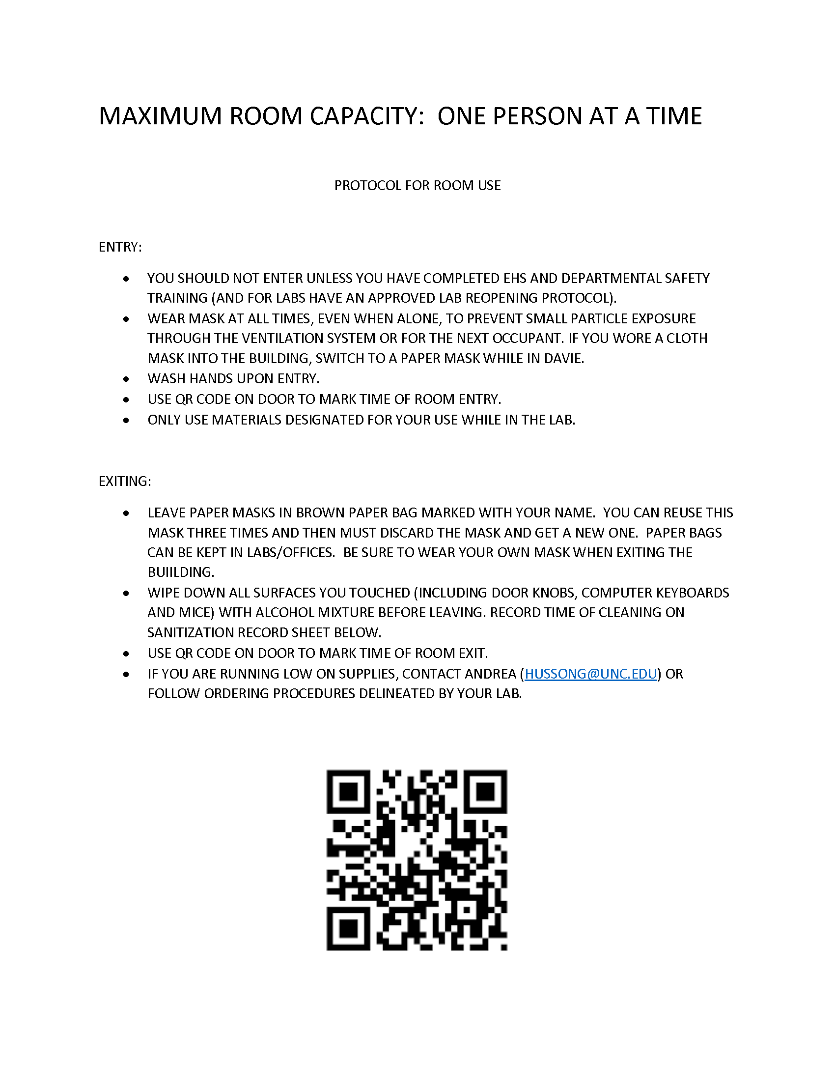

Slide 12
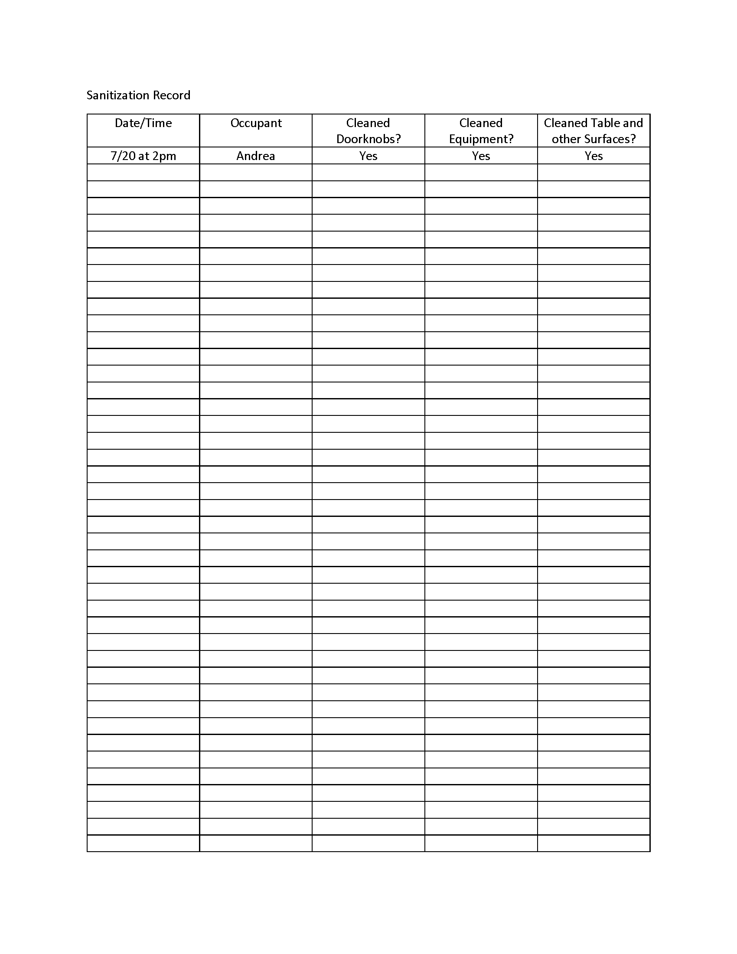

Slide 13
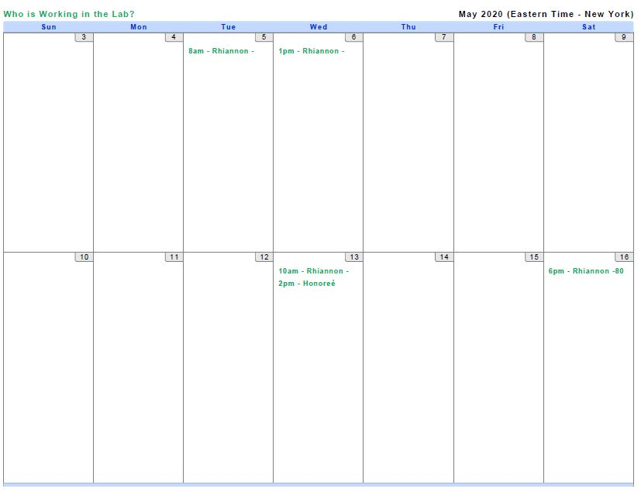
SOCIAL DISTANCING: PEOPLE
With an eye toward < 50% lab and building occupancy, we recommend strategies such as:
Stagger arrival/departure times by at least 30 minutes.
Designated shifts, days of the week.
Develop a strategy to schedule, as well as to track entry/exit (e.g., Google Calendar/Sheets).
IInclude weekdays and weekends in your scheduling.
Avoid working alone during late hours and consider a “virtual buddy system” in case you need assistance.

Slide 14
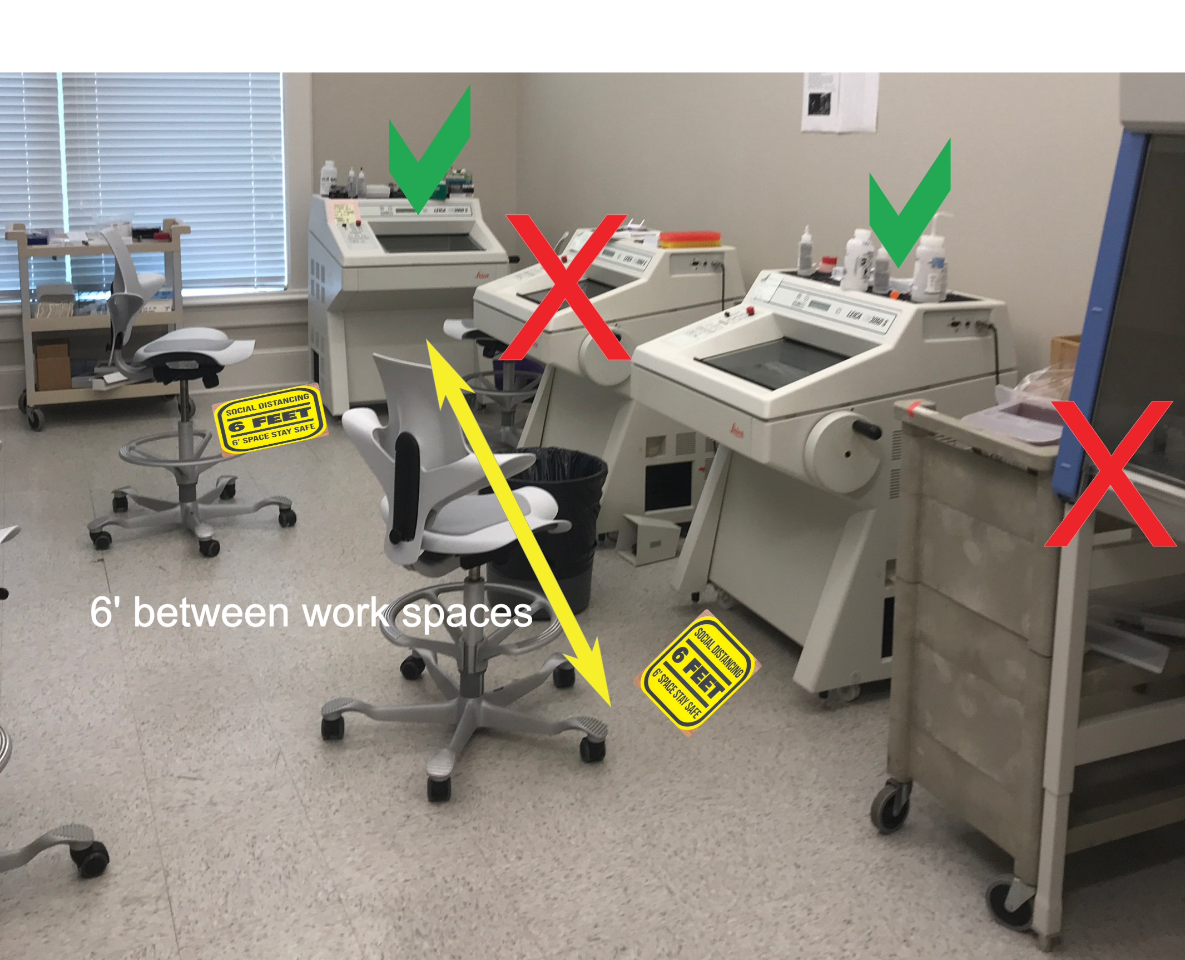
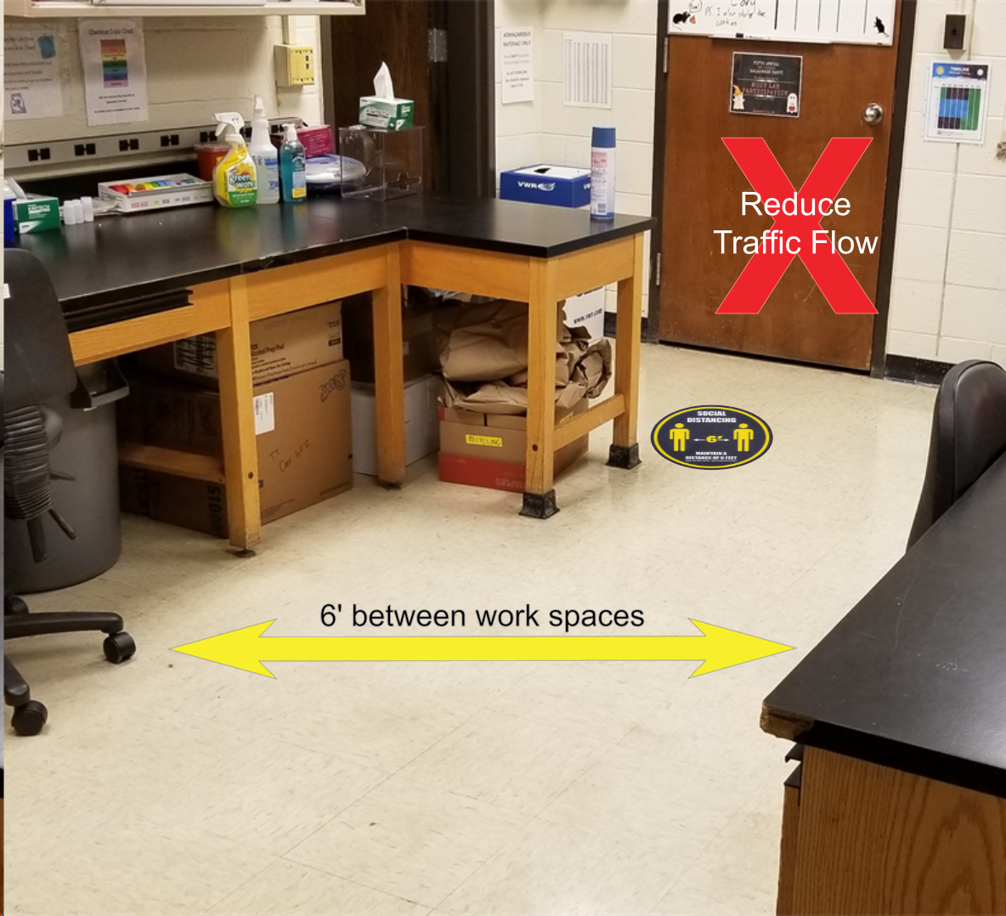
SOCIAL DISTANCING: SPACE
Remove excess chairs to decrease risk for congregating.
Limit one person/200 square feet of space (i.e., may mean 1 person/room)
If you have more than 400 sq ft/room, maintain 6 ft distance (see lab re-opening examples for sample exceptions).
Eliminate multiple entries to control flow.
Use tape or floor decals to provide visual reminders regarding physical distancing

Slide 15
Part II: PLAN AND SCHEDULE FOR CLEANING AND SANITIZING
Include a plan and schedule for sanitization practices in your lab:
How often will surfaces be sanitized?
What is your protocol for sanitizing equipment?
When will personnel wash and sanitize their hands while in the lab?

Slide 16
PART II: PLAN & SCHEDULE FOR CLEANING & SANITIZING
Plans for & logging of sanitization of shared space (including table tops) is required.
Recommended sanitizing practices include:
  Spray surfaces with CDC-recommended sanitizing solutions
  Use 70% ETOH solution on door key codes/alarm pads to prevent deterioration of rubber parts
  70% ETOH wipes may be best for instruments, including computers
  Shipped supplies and boxes should also be disinfected
  Commercial disinfectants approved by the EPA can be found here:
  https://www.epa.gov/pesticide-registration/list-n-disinfectants-use-against-sars-cov-2

Slide 17
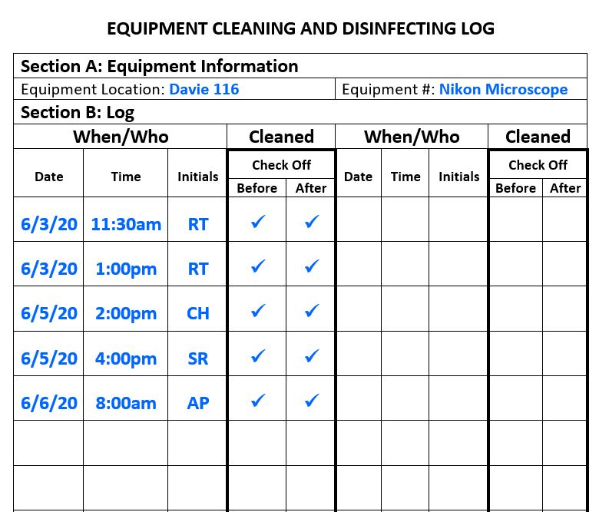
SAMPLE SANITIZING LOG
Use of shared equipment should be coordinated and tracked.
Consider posting reminders regarding expectations in the physical space and/or on the equipment.
Use some sort of shared calendar to track both use as well as cleaning.

Slide 18
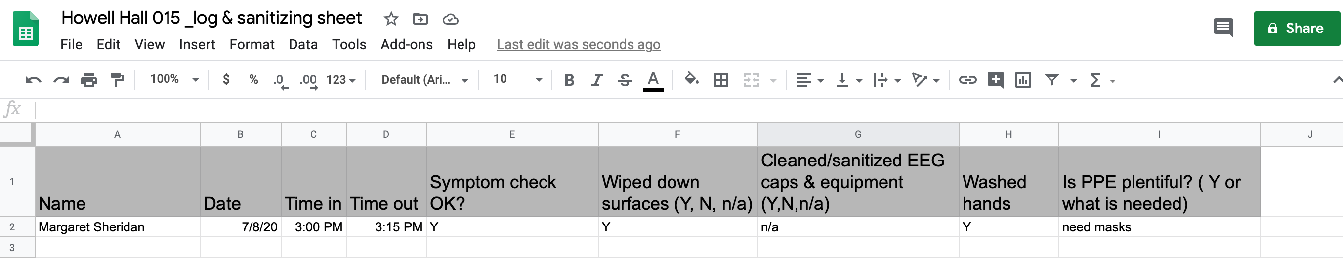
Sample Sanitizing Log
Use of shared equipment should be coordinated and tracked.
Consider posting reminders regarding expectations in the physical space and/or on the equipment.
Use some sort of shared calendar to track both use, as well as cleaning.

Slide 19
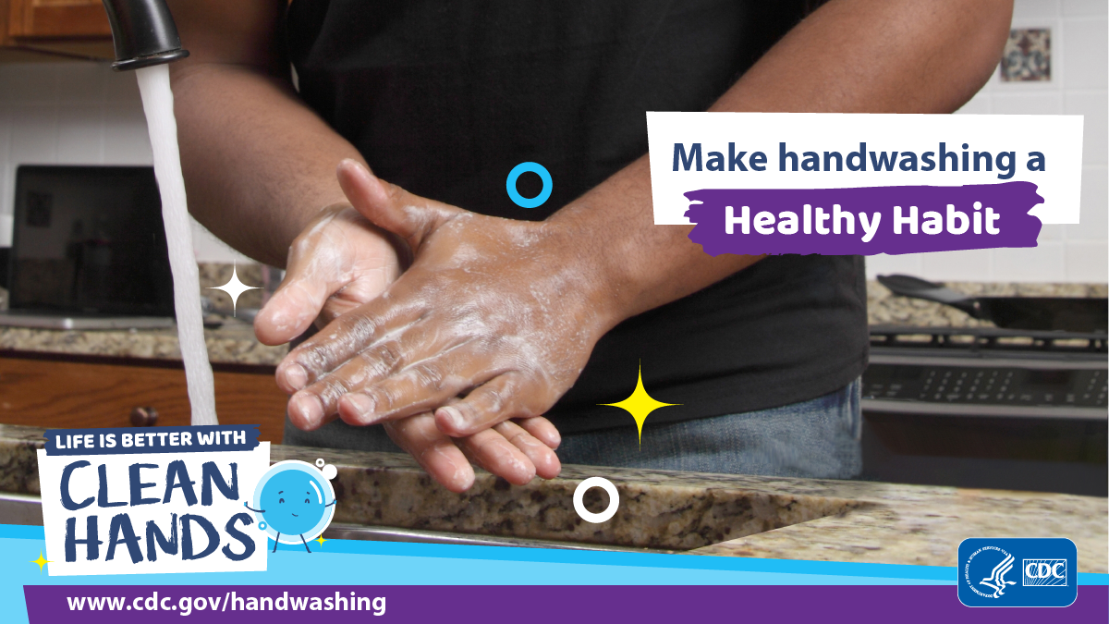
REDCING EXPOSURE – HYGIENE
Follow good handwashing procedures – 20 seconds of soap and warm water - upon entering the lab, between glove changes and before leaving the lab.
Cover any coughs or sneezes with tissue. Immediately wash your hands afterwards.
Use hand sanitizer with at least 60% alcohol content if soap and water are not available.

Slide 20
PART II: PLANS FOR MASKS (AND OTHER PPE)
What is your policy for wearing masks in the lab?

Slide 21
PART II: PLAN FOR MASKS (AND OTHER PPE/CPE)
The University and College plan re: procurement for PPE/CPE, including for HS research, continues to unfold.
There is a current PPE/CPE supply (e.g., masks, disinfectant solution, wipes, paper towels, & hand sanitzer). in Davie 202 to get PIs, lab staff, & students re-started (see https://psychology.unc.edu/covid/ for link to inventory and sign-out).
OVCR specifies that PIs must provide PPE/CPE for their labs & study protocols; yet, recent policy updates also indicate that no University (i.e., any chartstring) account (e.g., grants, F & A, trust) can be used to to purchase PPE/CPE over and above what is outlined in the campus community standards or required by EHS.
Our Department is helping us to interpret and navigate those parameters by maintaining a centralized PPE/CPE supply and ordering system, including covering the cost for standard PPE/CPE. The link above will be updated for orders, which will be handled by Tre’ Rush. If you have specific needs that fall outside of this scope, please talk to Chase Debman (chase@unc.edu).
At a minimum, each lab PPE/CPE supply should include:
  OVCR-approved masks, as well as brown paper bags for mask storage
  Hand sanitizer
  70% alcohol solution or other approved disinfectant (Lysol, dilute bleach, Virkon S) and/or wipes to clean work spaces, door knobs, & equipment
Given airborne spread data, labs may also consider HEPA air-filter(s), particularly for interior/poorly ventilated spaces.
Labs may also consider keyboard covers, wrapping computer mice in Ziploc bags for shared workstations, plexiglass barriers [Philip Thompson (philip@email.unc.edu)], and/or face shields [Kyle Glochick (kyle@beam.unc.edu)].

Slide 22
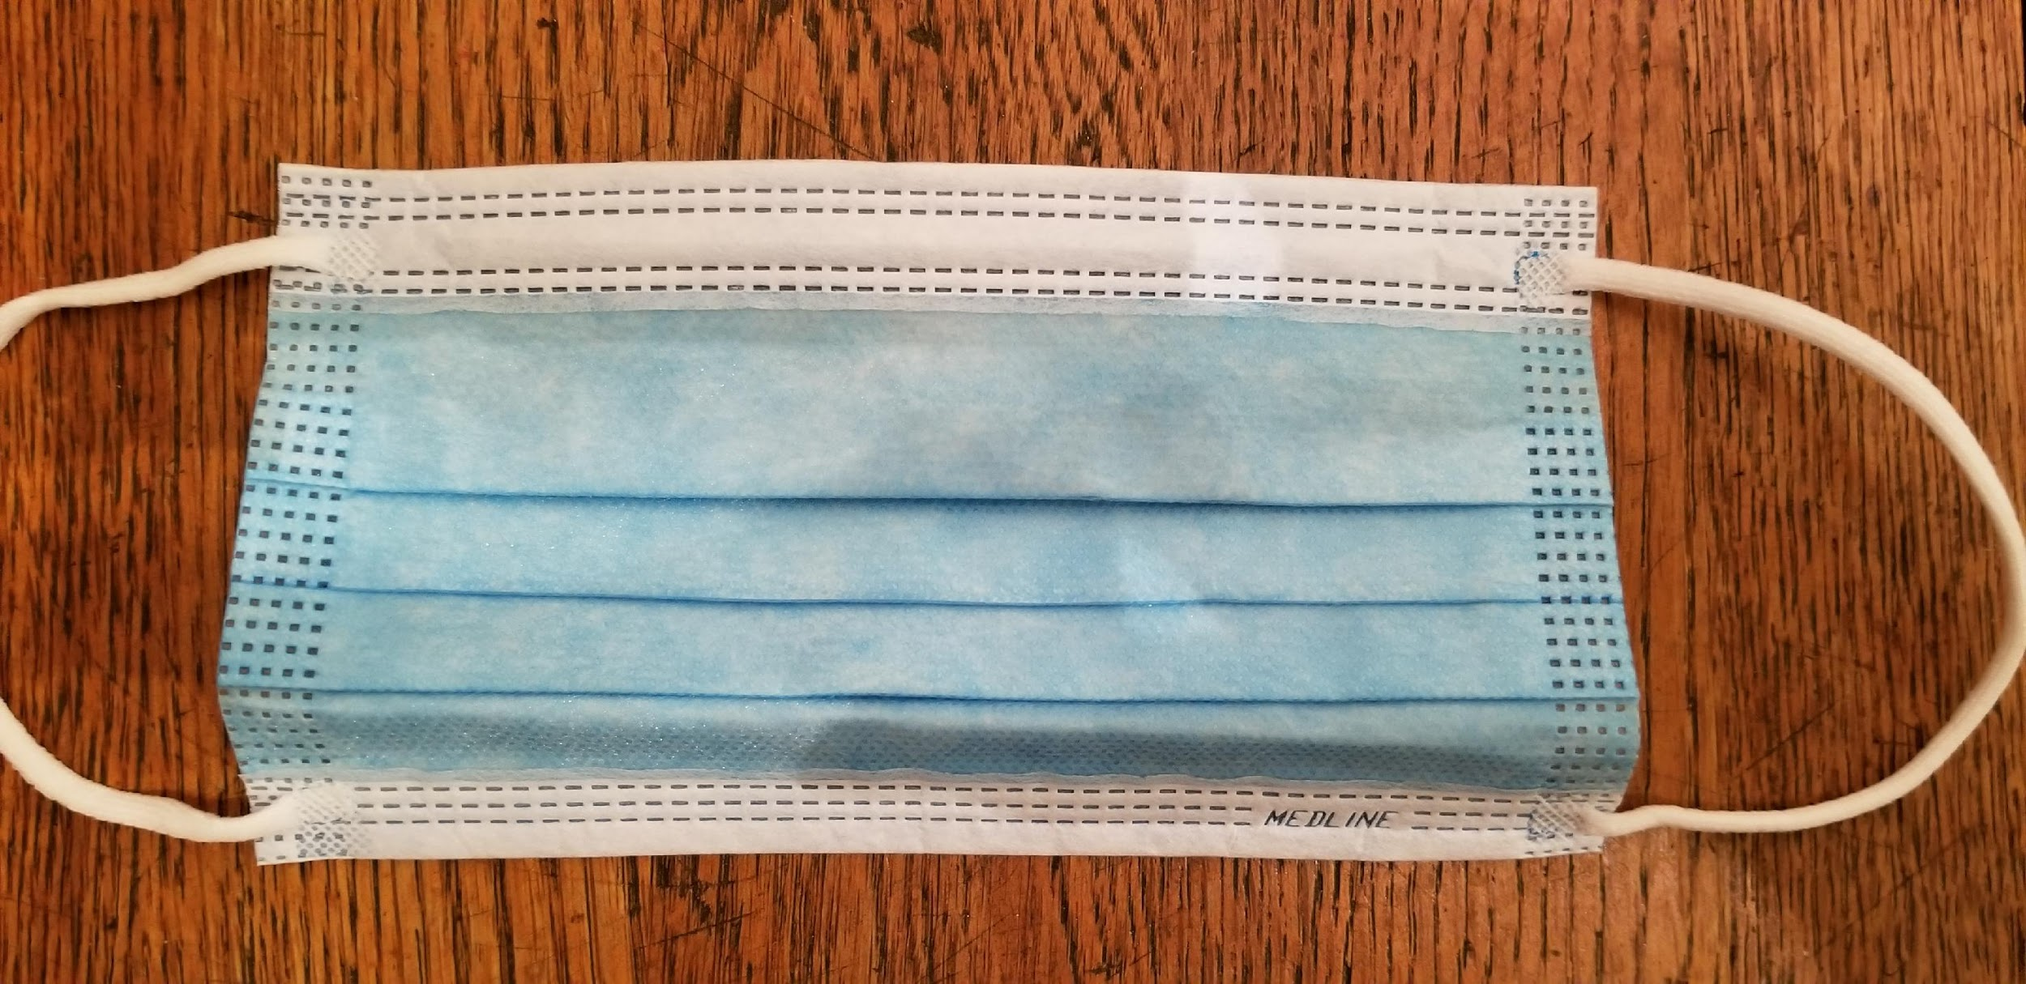
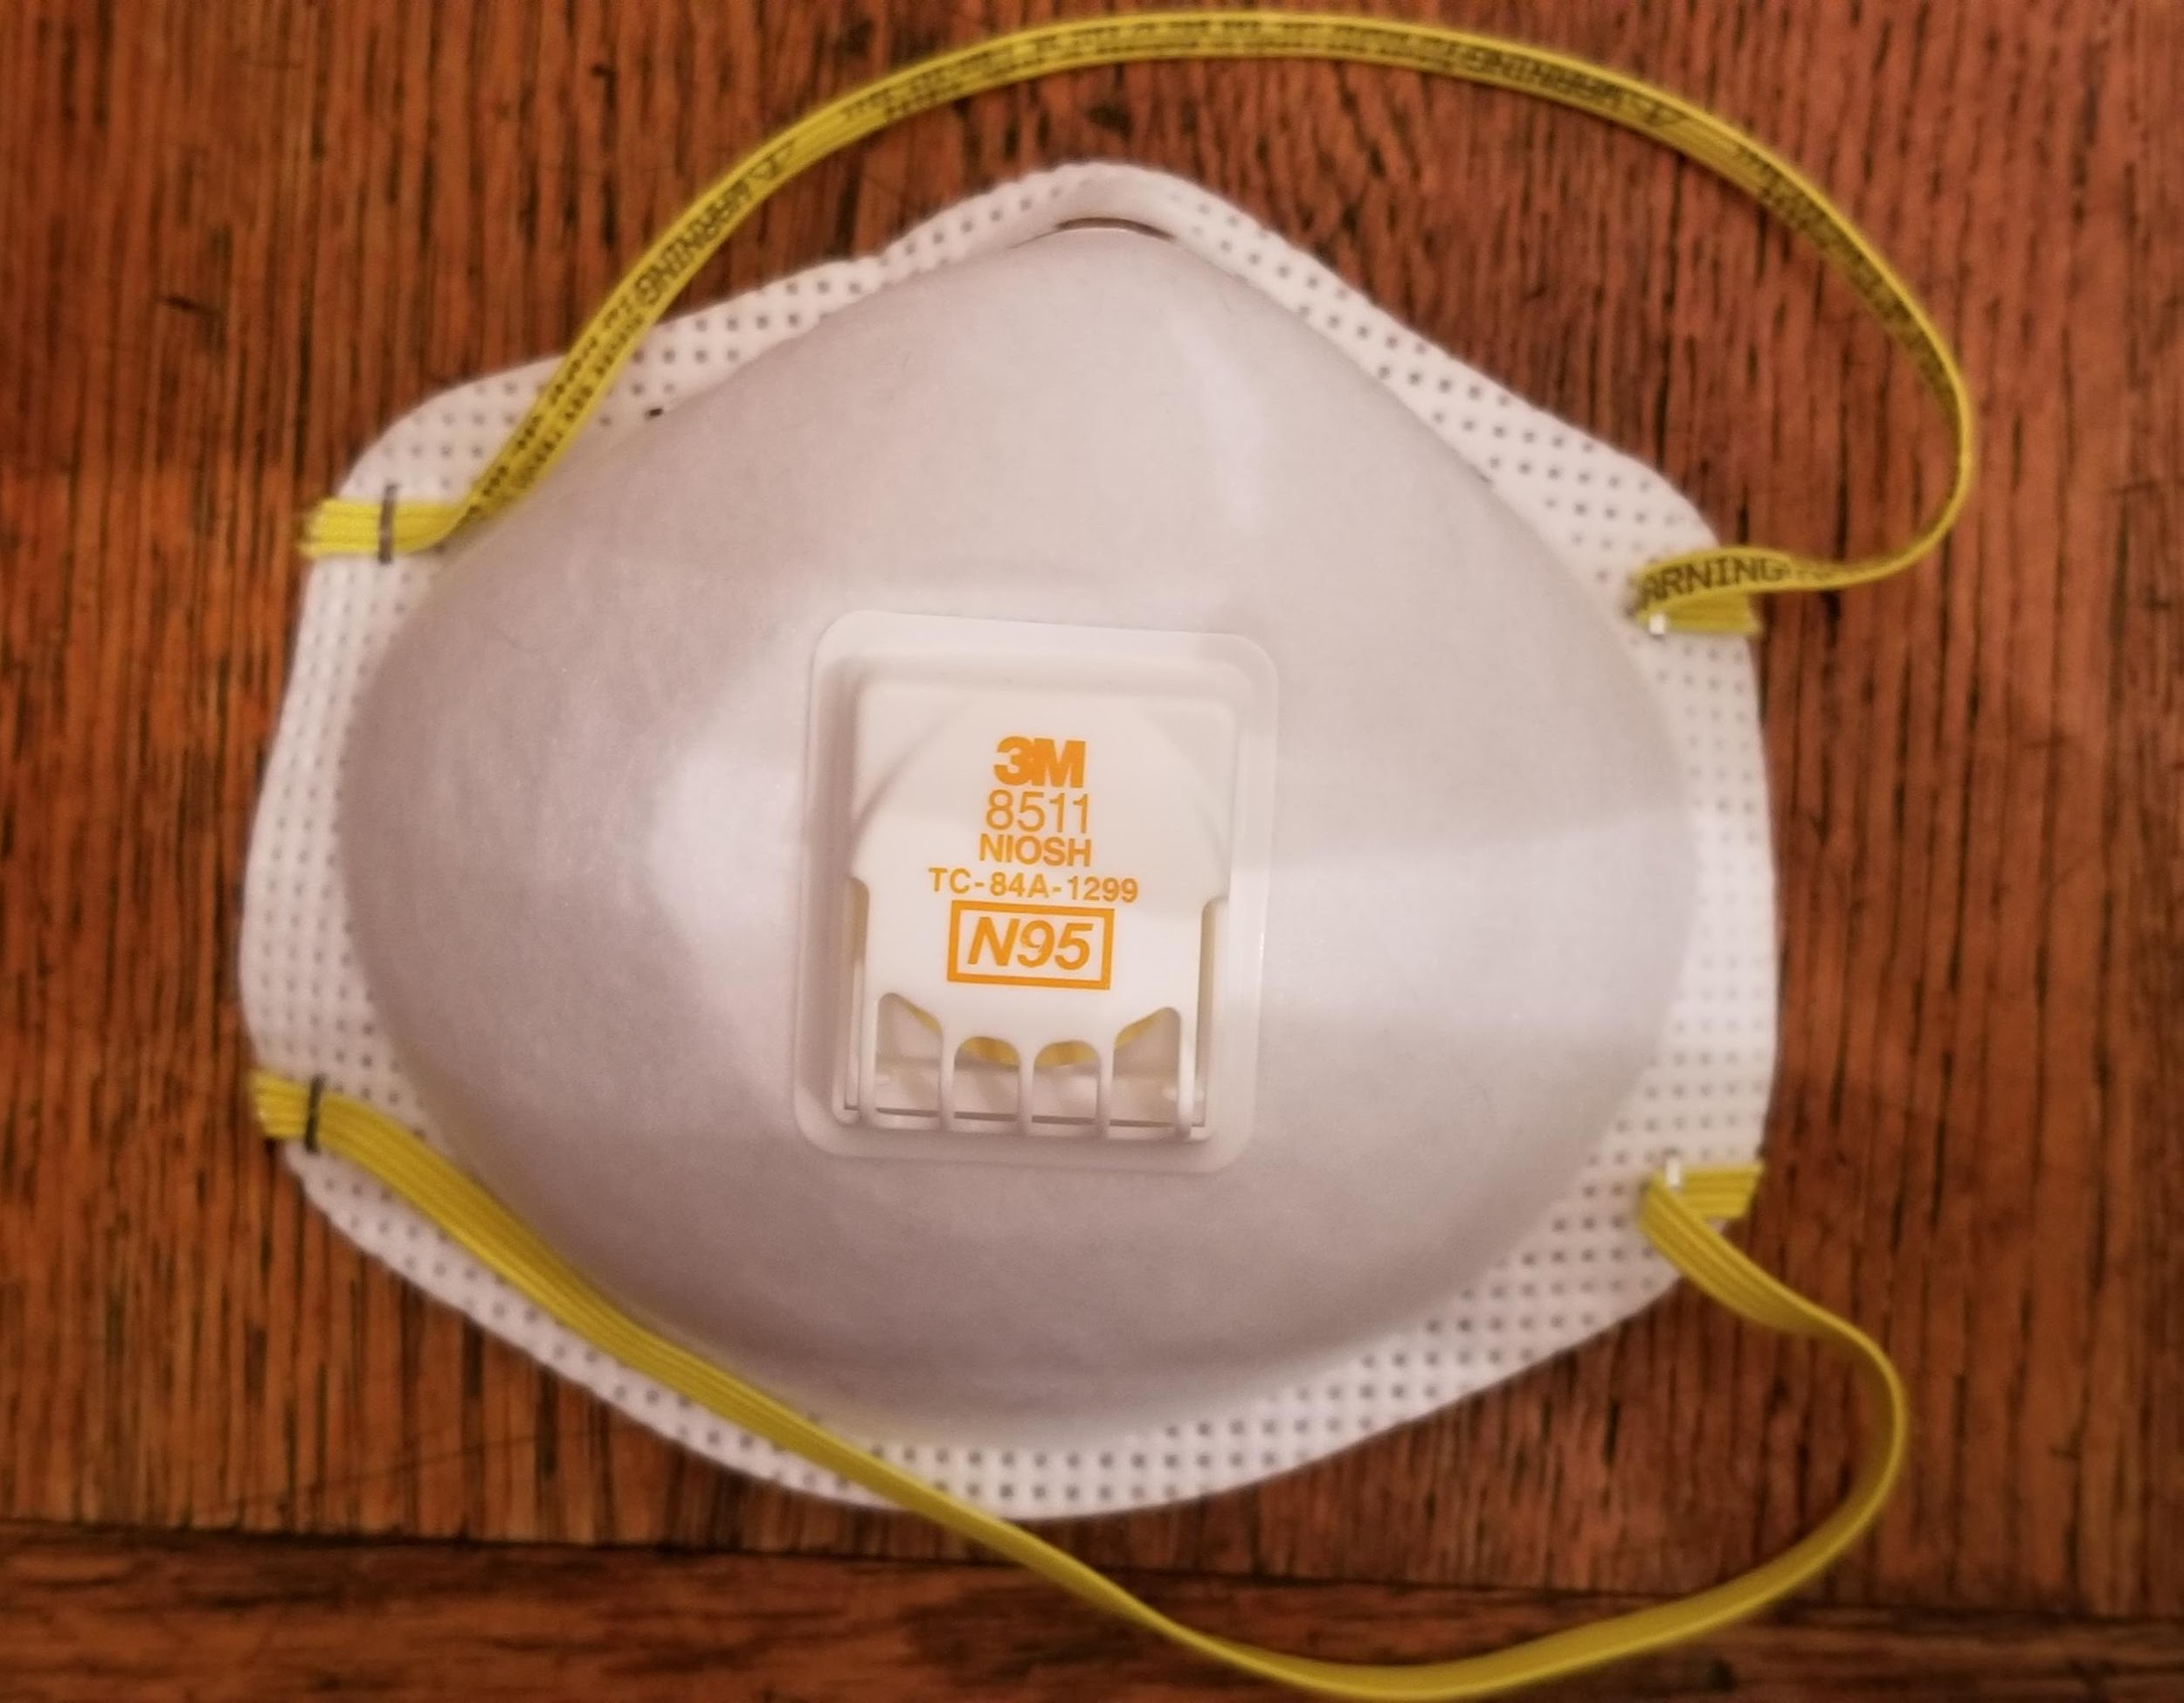
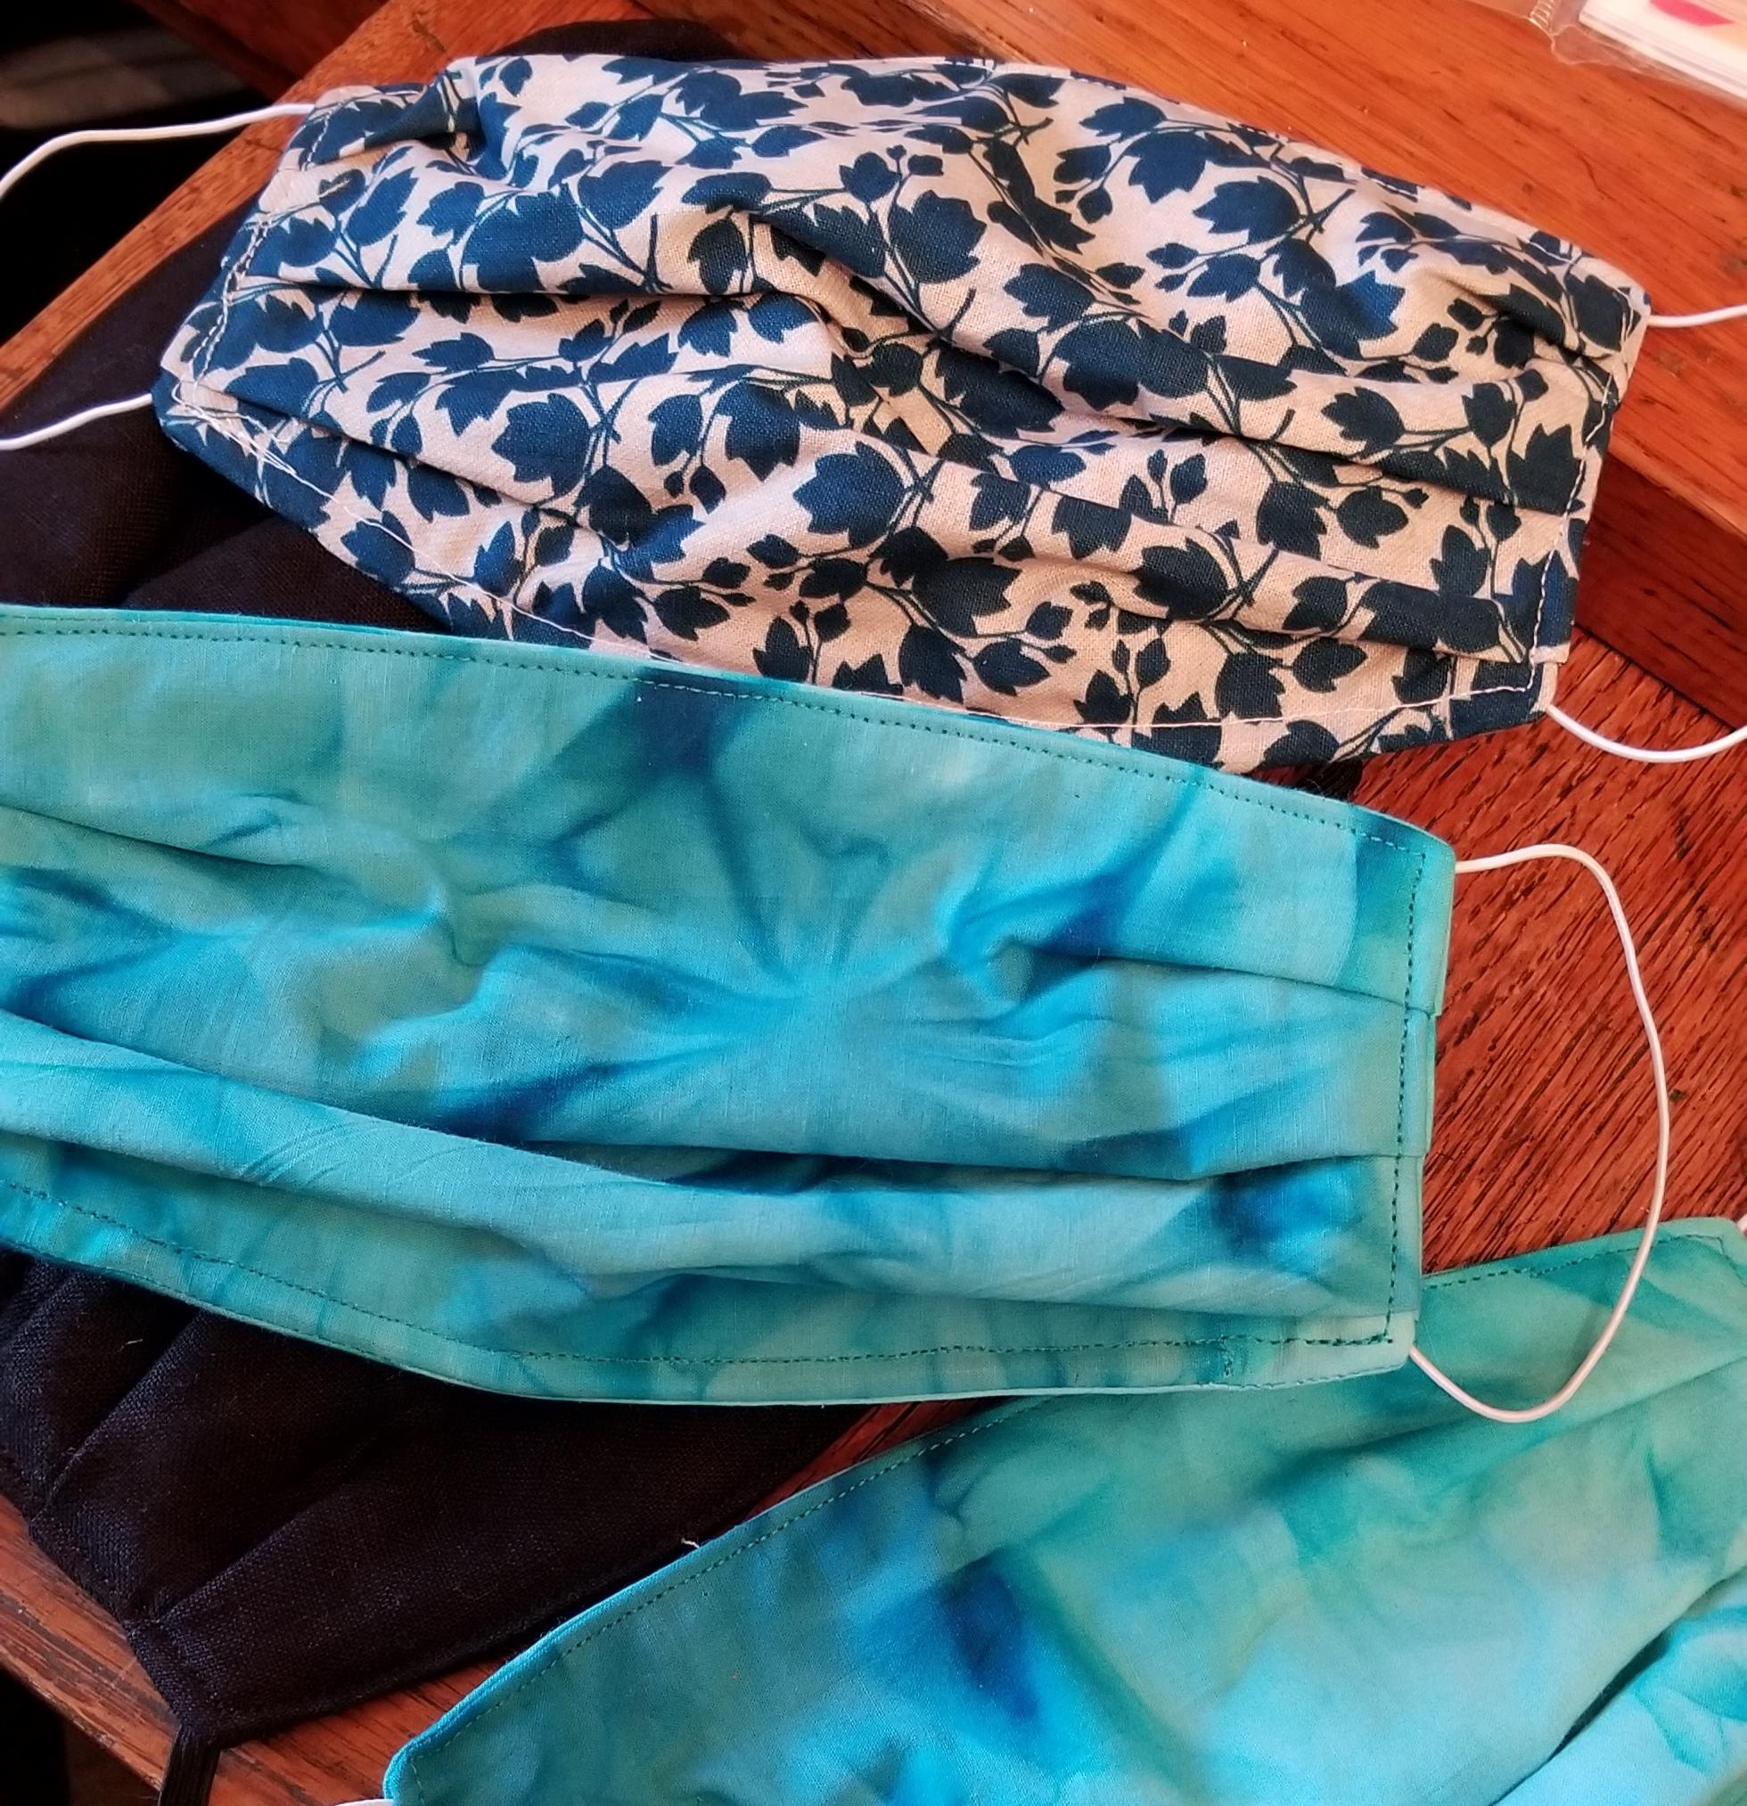
PART II: PLAN FOR MASKS (AND OTHER PPE)
X
Dust/Paper Masks should used in the laboratory along with other PPE.
Dust/Paper masks can be reused if not soiled, contaminated or damaged.
An individual can store a used paper mask inside a clean paper bag with name until next use. Do not seal the bag.
Replace the dust/paper mask every three days of use. These mask types cannot be washed.
N95 Masks are designed for front-line employees, health care workers and lab members who have a high risk for exposure to contaminants.
N95 masks are reusable and designed to block 95% of particles at the .3 micron level.
Users must complete training with EHS and be fit tested before using them.
More information on UNC’s EHS N95 program can be found here: https://ehs.unc.edu/workplace-safety/rpp/
Although cloth masks are common, OVCR requires the use of Dust/Paper or N95 masks for research.
For more information on the CDC’s advice on cloth masks, visit: https://www.cdc.gov/coronavirus/2019-ncov/prevent-getting-sick/diy-cloth-face-coverings.html

Slide 23
REDUCING EXPOSURE - MASKS
X
Carefully remove the mask, utilizing the elastic.
Do not touch the front of the mask or your face during or after removal!
Wash your hands or use hand sanitizer.
CDC guidelines for removing masks safely: https://www.cdc.gov/coronavirus/2019-ncov/downloads/cloth-face-covering.pdf

Slide 24
PART II: ADDITIONAL SAFETY CONSIDERATIONS (WELLNESS CHECK)
In an effort to protect the safety and well-being of employees, providers, participants, and the community at large; all employees/providers should conduct a wellness check prior to the start of every shift.
Although the specifics are up to individual labs, the general requirements state that the employee wellness checks must be performed by another responsible party (e.g. supervisor or PI) or self-reporting via an online system prior to reporting to work COVID-19 Wellness Check
Individuals found to be positive for symptoms consistent with COVID-19 will either not report to or immediately leave work (not enter the facility) & be advised to contact:
OHS at 919-966-9119.
Chase Debnam, Department Manager
** If you are working in a UNC building(s )other than Davie or Howell Halls as well,
please refer to their specific guidance re: wellness checks**

Slide 25
PART II: ADDITIONAL SAFETY CONSIDERATIONS (WELLNESS CHECK)
The employee wellness check should include the following questions (subject to change based on CDC guidelines):
Do you have new muscle aches not related to another medical condition or another specific activity (e.g. due to physical exercise)? (If so, take temperature)
Do you feel like you may have a temperature of greater than 100.0°F? (If so, take temperature)
Do you have sore throat not related to another medical condition (e.g. allergies)?
Do you have a new or worsening cough that is not related to another medical condition?
Do you have shortness of breath that is not attributable to another medical condition?
Do you have recent (<5 days) loss of smell and taste?
Do you have new onset of vomiting or diarrhea not related to another medical condition?
Do you have repeated shaking chills not related to another medical condition?

Slide 26
PART II: TEMPLATE PLEDGE AND SIGNATURES
ALL LAB MEMBERS:
By signing and providing the relevant dates below, I pledge that I have competed the required EHS
“Protecting the Carolina Community” and participated in the Department’s lab reopening training (July
20,2020) or watched the recording in its entirety.
In addition, I pledge to adhere to the policies in my lab, department, and the University regarding
measures to help prevent the spread of COVID-19 to protect myself, my peers and everyone I encounter
who is working during this pandemic.
PI:
By signing below, the Principal Investigator further agrees to oversee the implementation of the policies set forth in this document and understands that violations of policy will be addressed through one or two warnings that will ultimately result in HR action and suspension of on-site research activity for either one individual or the entire group.

Slide 27
HERE WE GO THROUGH EXAMPLE(S)

Slide 28
PART III: PI SUBMITS NEW/MODIFIED STUDY PROTOCOLS TO IRB

Slide 29
PART III: OVERVIEW
Whereas the “Group Resumption of Lab Operations” submitted to the Department focuses on lab re-opening with regard to space, sanitization, and masks (other PPE), all new and/or COVID-related revisions to current study protocols must be submitted to the IRB for review & approval.
Here we try to provide highlights of the current standards and procedures; however, PIs should routinely consult the most up-to-date information: https://research.unc.edu/2020/03/10/ohre-irb-covid-19-update/
As stated on that website: “As a reminder, initiating research or modifications to research without IRB review and approval is not permitted, except where necessary to eliminate apparent immediate hazards to the human subjects per DHHS OHRP and FDA regulations”.

Slide 30
PART III: GENERAL GUIDELINES RELATED TO IRB SUBMISSION/APPROVAL
Whenever possible, ongoing studies that were modified to conduct study visits/procedures via virtual/phone/remote formats should consider continuing as modified.
New studies being submitted to the IRB for initial approval should consider including virtual/phone/remote formats for as many procedures as possible.
Paused studies should modify some or all face-to-face procedures to virtual/phone/remote formats prior to re-starting the study if/when possible.
For studies initiating or resuming face-to-face, in person participant contact/interactions, we attempt to summarize additional information here; however, further detail is provided at: OVCR and OHRE COVID Updates

Slide 31
PART III: OVCR DIRECTION & GUIDANCE FOR HS RESEARCH
HS research that requires participant contact should adhere to the following:
  Face-to-face assessments/visits can continue, weighing risks & benefits for the participants, including CDC guidelines re: high-risk groups.
  Participants should know and understand risks, which is discussed later as it relates to the Information Sheet and Consent Process.
  During face-to-face visits, research staff should maintain a 6 feet physical distance when possible, wear an approved face mask, and wash /sanitize hands and equipment as per approved “Group Resumption of Lab Operations”.
  Interactions should take place in an outdoor setting, if possible.

Slide 32
A reminder of the definition of “Minimal Risk” research
“Minimal risk” as defined by Federal Regulations - 45 CFR 46, §46.102 (i):
“The probability and magnitude of harm or discomfort anticipated in the research are not greater in and of themselves than those ordinarily encountered in daily life or during the performance of routine physical or psychological examinations or tests.”
By that definition, although the risks encountered in ordinary daily life or in routine physical examinations are certainly higher than they were 6 months ago, our research procedures "in and of themselves" do not present greater risk.

Slide 33
PART III: OVCR DIRECTION & GUIDANCE FOR HS RESEARCH (CONT)
Prior to a face-to-face visit, research staff must confirm appointment & do telephone wellness screens no more than 24 hours in advance.
These screening questions should be asked for all participants:
Do you feel feverish or do you have a fever?
Do you have a new or worsening cough?
Do you have a new or worsening sore throat?
Are you newly short of breath?
Have you had a loss of taste or smell in the last 5 days?
Do you have new onset vomiting or diarrhea?
Do you have new onset of repeated shaking with chills not related to another medical condition?
Any participant who screens positive should be referred to:
UNC Health COVID-19 HelpLine at 1-888-850-2684
for additional screening and further instructions
Note: If working in a UNC health care facility, please see additional OVCHR guidance regarding screening, temperature checks, etc. on their website.

Slide 34
PART III: OVCR DIRECTION & GUIDANCE FOR HS RESEARCH (CONT)
Research that involves 10 or fewer individuals in a group (e.g., focus group) is allowed presuming 6 ft of physical distance is possible between all participants & all wear masks.
If research involves travel or overnight stays, accommodation and meals should allow for adequate physical distancing (6 feet or more) wherever feasible. Vehicle occupancy should be limited to no more than 2 people in a standard car, with open windows while travelling, if possible. Vehicle occupants should wear masks. (Note: Travel for UNC business is currently restricted to NC; for updates see University Transportation & Parking website).
When a participant is not able to mask, staff must wear eye protection in addition to a mask (e.g., a face shield, a face mask with attached face shield, or safety goggles or glasses that offer wrap around protection to the side of the eyes). Standard prescription glasses are not eye protection. All eye protection equipment should be disinfected after use.
Gloves are at the discretion of the project but handwashing/sanitizer is best practice and is a minimum standard.
Anyone accompanying someone to a research appointment, but not directly involved in the research, should be asked to remain outside of the building.
With the exception of minors accompanied by parents/guardians, anyone accompanying a participant who is not directly involved in the research should be asked to remain outside of the building.
Additional safety procedures may be needed for studies of vulnerable populations (e.g.,older adults, identified health conditions) .

Slide 35
PART III: COVID-19 SCREENING AND/OR MODIFICATIONS
1. COVID-19 Screening Purposes ONLY: If you need to screen subjects for coronavirus or COVID-19, this is not considered a “research activity” and can be done without IRB approval, provided you are not using this data for research purposes.
2. Other COVID-19 Modifications: If you need to alter your research processes from currently IRB approved processes or forms due to COVID-19, IRB instructs that PIs submit these as modifications and in the coversheet please state “COVID-19” and include your justification.
Modifications may include, but are not limited to changes to: consent, delivery method (e.g., remote, electronic), personnel changes (e.g., to ensure coverage), and/or postponement and/or suspension of some or all of study activities (please see OVCR’s COVID Submission Table IRB posted on our website: https://psychology.unc.edu/covid/ for additional guidance).
Modification submissions should include:
Any changes to the consent process, including alterations/waivers of signature or other elements as required.
Subjects requiring samples to be drawn as part of their research participation may be allowed to have samples collected at another organization, such as their local provider clinic, provided that this group routinely provides sample collections as a service.
If a subject is unable to travel to UNC there may be other options available for them to have a sample collected for research purposes. Please consult with OHRE for further guidance.
Research involving undergrads (research participation subject pool) should be modified taking into account the possibility that these individuals will have a hard time complying with social distancing if they are living in dorms and attending in person classes.

Slide 36
PART III: COVID-RELATED MODIFICATIONS TO CONSENT PROCESS
  As part of the ongoing consent process, participants, especially those at high risk for severe negative outcomes, should understand the risks related to any breach or potential breach of distancing.
  The OHRE/IRB has provided a fill-in the-blank COVID Information Sheet to provide to participants for this purpose. Using form “as is” does not require permission (an IRB modification) to your protocol (the form and companion OVCR letter can be found at: https://psychology.unc.edu/covid/)
  Prior to participants visiting campus (or meeting at a non-campus location), research staff should explain potential risks of doing the visit during COVID-19, provide an opportunity for participants to ask questions, & confirm that participants agree willingly to the visit.
  Remote consent is encouraged if approval has been granted by the IRB.
  For additional UNC Health Guidance on COVID-19, please visit the Clinical Research Support Office (CRSO)’s response page.

Slide 37
PART III: COVID-RELATED MODIFICATIONS FOR REMOTE ACTIVITIES
Consistent with pre-COVID practice, certification of IRBIS submissions confirms PIs will use the IT systems designated by the respective IRBIS security tier, this also includes sharing data with sponsors or others outside of UNC. These standards remain in place.
The Safe Computing at UNC site and specifically Zoom at UNC can both be used as resources to help identify strategies or ways to appropriately communicate and share, which may include solutions such as “OneDrive and Office 365”.
If you need guidance regarding appropriate settings and accounts (e.g., FDA Part 11 Compliance, PHI, and FERPA), OHRE recommends contacting your Information Security Liaisons (ISL)/IT Liaison and involving them prior to submitting.
The ITL for our Department is: Hugh Meriwether (hugh_meriwether@unc.edu)

Slide 38
PART III: COVID-RELATED CONSIDERATIONS FIELD-BASED RESEARCH
University-approved masks should always be worn.
Gloves should be considered if directly interacting with or exchanging items with another individual; however, handwashing and/or sanitizing still considered best practice.
Guidelines for physical distancing (minimum 6 feet distance while wearing a mask) should be followed.
Consider outside venues whenever possible.
Clean and sanitize all materials and equipment using previously discussed standards before and after study staff and participant use; if requiring participant to clean and sanitize after own use, provide instructions and supplies.
Follow any site-specific guidelines, including additional PPE requirements.

Slide 39
Part III: COVID-Related CONSIDERATIONS BIOSPECIMENS
Collection & processing of human biospecimens with unknown coronavirus SARS-CoV-2 status for research presents risk, as all except urine are potentially infectious. Nature Med May 2020
Thus, it is essential to prepare, store, handle, and ship biospecimens according to the universal precautions (https://research.ucsf.edu/covid-19-biospecimen-guidelines).
Universal precautions means wearing appropriate PPE (gloves, lab coats/coveralls/gowns, eye protection) even when you think it may not be necessary.
It is mandatory to handle biospecimens at biosafety level 2 (BSL-2) and to use class II biosafety workbenches (https://www.cdc.gov/coronavirus/2019-ncov/lab/lab-biosafety-guidelines.html).
Note that saliva samples collected with DNA-genotek collection kits contain a component which will inactivate SARS-CoV-2 (see document: https://dnagenotek.com/US/pdf/MK-01430.pdf). The document also notes that you can heat-treat saliva samples as a precautionary step to inactivate the SARS-CoV-2 virus.

Slide 40
Part III: COVID-RELATED CONSIDERATIONS DEPARTMENT SUBJECT POOL
The subject pool will be open, and students in PSYC 101 will be required to complete either:
6.5 hours of participation in studies
a reading assignment with Sakai quiz
The only change is that now students can fulfill the study participation requirement through as many hours of online studies as they want (i.e., previous limit of 1.5 hours online studies).
We may see more students choosing the reading assignment for Fall 2020, but it is also likely that there will be many students looking for online studies for course credit.

Slide 41
PART IV: PI SUBMITS IRB STUDY APPROVAL(S) TO DEPARTMENT

Slide 42
PART IV: POST-IRB APPROVAL STUDY SUBMISSION/REVIEW
** STAY TUNED**

Slide 43
FOR MORE INFORMATION FROM THE UNC OVCHR:
For overall UNC research information, visit: DIRECTION AND GUIDANCE FOR ALL ON-CAMPUS RESEARCH AT UNC
For UNC research lab specific information, visit: LABORATORY-BASED RESEARCH for more information
For more information and updates regarding parking on campus, please visit:
University Transportation & Parking website
The office of the Vice Chancellor of Research will hold periodic Q&A sessions, as needed. More information and scheduling can be found at: UNC Research COVID-19 website.
Individuals with questions may email the office at vcr@unc.edu.
For additional questions regarding COVID-19, visit the UNC Coronavirus website and the UNC Health Coronavirus website.

Slide 44
DEPARTMENT INFORMATION AND RESOURCES
A recording of this training will be posted on the Department’s Research & COVID Website along with other materials, including those mentioned today. https://psychology.unc.edu/covid/
Additional information will be forthcoming re: similar policies and procedures related to classroom, common, and office space in our buildings.
Things continue to evolve and change and we will do our best to provide updates ASAP.

